Slide 1
ADVANCED OBJECT ORIENTED PROGRAMMING
PROJECT REVIEW-1

Slide 2
TEAM MEMBERS
2110030020-CHITTA SRI CHANDANA
2110030032-DEVINEEDI NEHA
2110030056-BODDU AKSHITA
2110030457-VELANATI CHARISHMA
UNDER THE GUIDANCE OF
MRS.FIGLU MOHANTY

Slide 3
PROBLEM STATEMENT AND DOMAIN
Passwords are difficult to remember, and users have many accounts that require passwords. This causes users to choose memorable but weak passwords and then reuse them, which creates major security problems.
We propose a method for users to only need to remember one password that they use to access all their other passwords from any device at any time.
Its comes under Software Domain.

Slide 4
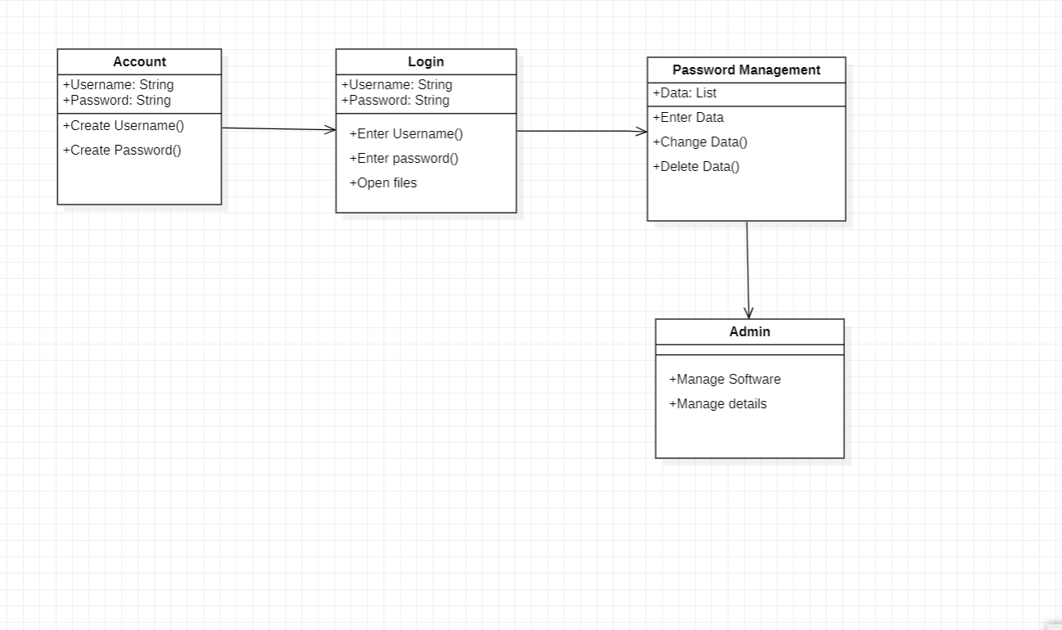
CLASS DIAGRAM

Slide 5
HOW IT WORKS
Password management software is a utility you can use to save and retrieve all your passwords. This software could be a standalone application on your local computer or a feature within another application. This option greatly limits hackers' possible routes to your password data while adding convenient features for organizing and retrieving information.
The password manager generates a random number between 1 and 4 with help of FOR LOOP to choose the character set.
Once the set has been randomly selected a random index will be generated for the selected character set.

Slide 6
CONTRIBUTION OF TEAM MEMBERS
2110030020-Chitta Sri Chandana-Class Diagram
2110030032-Devineedi Neha-PPT, Class Diagram
2110030056-Boddu Akshita-PPT, Information
2110030457-Velanati Charishma-PPT

Slide 7
Thank You

